Slide 1
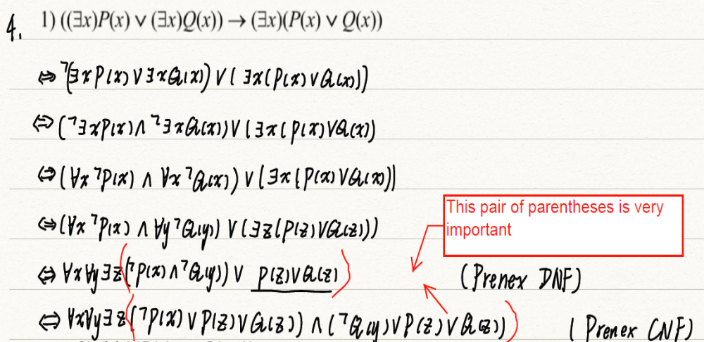

Slide 2
CHAPTER 3 Algorithms
3.1 Algorithms
3.2 The Growth of Functions
3.3 Complexity of Algorithms

Slide 3
3.1 Algorithm
1. Introduction
To solve a given problem:
Setting up the appropriate mathematical model.
Developing an algorithm.
An algorithm is a finite set of precise instructions for performing a computation or for solving a problem.

Slide 4
3.1 Algorithm
〖Example 1〗 Describe an algorithm for finding the maximum (largest) value in a finite sequence of integers.
Solution :
a₁ , a₂ , a₃ ,… , a_{n}
Set the temporary maximum equal to the first integer in the sequence.
Compare the next integer in the sequence to the temporary maximum, and if it is larger than the temporary maximum, set the temporary maximum equal to this integer.
3. Repeat the previous step if there are more integers in the sequence.
4. Stop when there are no integers left in the sequence. The temporary maximum at this point is the largest integer in the sequence.

Slide 5




3.1 Algorithm
Pseudocode: Instructions given in a generic language similar to a computer language such as C++ or Pascal.
A pseudocode description of the algorithm for finding the maximum value in a finite sequence follows.
ALGORITHM 1 Finding the Maximum Element in
a Finite Sequence.
Procedure max( : integers)
max : =
For i : = 2 to n
If max then max
{ max is the largest element}

Slide 6
3.1 Algorithm
Common properties of algorithms:
Input ---- An algorithm has input values from a specified set.
Output ---- From each set of input values, an algorithm produces output values from a specified set.
Definiteness ---- The steps of an algorithm must be defined precisely.
Correctness ---- An algorithm should produce the correct output values for each set of input values.
Finiteness ---- An algorithm should produce the desired output after a finite number of steps for any input in the set.
Effectiveness ---- Each step of an algorithm must be executed exactly and in a finite amount of time.
Generality ---- The procedure should be applicable for all problems of the desired form, not just for a particular set of input values.

Slide 7
3.1 Algorithm
2. Searching Algorithms
The general searching problem:
Locate an element x in a list of distinct elements
,
or determine that it is not in the list.

Slide 8


3.1 Algorithm
(1) Linear Search or sequential search
ALGORITHM 2 The Linear Search Algorithm.
Procedure linear search (x: integer,
: distinct integers)
i : = 1
While ( )
i : = i+ 1
if then location : = i
else location : = 0
{location is the subscript of term that equals x ,or is 0 if x
is not found}
a
,
a
,
☹
,
a
1
2
n

Slide 9
3.1 Algorithm
(2) Binary Search
〖Example 2〗 To search for 88 in the list
5 13 19 21 37 56 64 75 80 88 92 100.
Solution :
(1) 5 13 19 21 37 56 64 75 80 88 92 100
(2) 64 75 80 88 92 100
(3) 88 92 100
(4) 88 92

Slide 10





3.1 Algorithm
ALGORITHM 3 The Binary Search Algorithm.
Procedure binary search (x: integer,
: increasing integers)
i : = 1{i is left endpoint of search interval }
j: =n { j is right endpoint of search interval }
while i < j
begin
m: =
if then
else
end
if then location : = i
else location : = 0
{location is the subscript of term equal to x ,or 0 if x is
not found }

Slide 11
3.1 Algorithm
3. Some other Algorithms
Sorting: Suppose that we have a list of elements of a set. Sorting is putting these elements into a list in which the elements are in increasing order.
Some typical sorting algorithms:
  -- The bubble sort
  -- The insertion sort
  -- The selection sort
  -- The binary insertion sort
  ……

Slide 12
3.1 Algorithm
Optimization problem: The goal of such problems is to find a solution to the given problem that either minimizes or maximizes the value of some parameter.
Algorithms that make what seems to be “best” choice at each step are called greedy algorithms.
Some examples,
-- The problem of making n cents change
-- Shortest Path Problems
……

Slide 13

Greedy Algorithms: Making Change
Example: Design a greedy algorithm for making change (in U.S. money) of n cents with the following coins: quarters (25 cents), dimes (10 cents), nickels (5 cents), and pennies (1 cent) , using the least total number of coins.
Idea: At each step choose the coin with the largest possible value that does not exceed the amount of change left.
  If n = 67 cents, first choose a quarter leaving 67−25 = 42 cents. Then choose another quarter leaving 42 −25 = 17 cents
  Then choose 1 dime, leaving 17 − 10 = 7 cents.
  Choose 1 nickel, leaving 7 – 5 – 2 cents.
  Choose a penny, leaving one cent. Choose another penny leaving 0 cents.

Slide 14
Greedy Change-Making Algorithm
Solution: Greedy change-making algorithm for n cents. The algorithm works with any coin denominations c₁, c₂, …,c_{r} .
procedure change (c₁, c₂, …, c_{r}: values of coins, where c₁> c₂> … > c_{r} ; n: a positive integer)
for i := 1 to r
d_{i} := 0 [d_{i} counts the coins of denomination c_{i}]
while n ≥ c_{i}
d_{i} := d_{i} + 1 [add a coin of denomination c_{i}]
n = n - c_{i}
[d_{i} counts the coins c_{i}]

Slide 15
Halting Problem
Example: Can we develop a procedure that takes as input a computer program along with its input and determines whether the program will eventually halt with that input.
Assume that there is such a procedure and call it H(P,I). The procedure H(P,I) takes as input a program P and the input I to P.
  H outputs “halt” if it is the case that P will stop when run with input I.
  Otherwise, H outputs “loops forever.”

Slide 16
CHAPTER 3 Algorithms
3.1 Algorithms
3.2 The Growth of Functions
3.3 Complexity of Algorithms

Slide 17
Factors to be considered for choosing an algorithm
3.2 The Growth of Function
Simplicity - Easy to implement and obviously correct
Clarity - Easy to read and to maintain
Extensibility - Can easily be extended to new tasks
Reusability - Can be adapted to different tasks
Efficiency - Uses time and space well (computation complexity)

Slide 18
Asymptotic Running Time
3.2 The Growth of Functions
A rough measurement of the running time of an algorithm based on the input size
  Gives you the relative rate of growth but not specific time of execution
  Allows for comparison of algorithms without implementation
  Not hardware specific

Slide 19
Asymptotic Running Time
3.2 The Growth of Functions
Asymptotic running time: the number of operations used by the algorithm as the input size approaches infinity
“Input size” depends on the problem being analyzed
  The number of items in the input is often used
  - Number of items in a searching algorithm
  May use more than one parameter
  - Number of edges and vertices in a graph

Slide 20
Growth of Functions- Motivation
3.2 The Growth of Functions
Suppose you are designing a web site to process user data (e.g., financial records).
Suppose algorithm A takes f_{A}(n)=30n+8 operations to process any n records, while algorithm B takes f_{B}(n)=n²+1 operations to process the n records.
Which program do you choose, knowing you’ll want to support millions of records?

Slide 21
Growth of Functions- Motivation
3.2 The Growth of Functions
f_{A}(n)=30n+8
Value of function 
f_{B}(n)=n²+1
Increasing n 

Slide 22
Big-O Notation
3.2 The Growth of Function
【Definition】 Let f and g be functions from Z(or R) to R. We say that “f(x) is O(g(x))” if there are constants C and k such that
  |f(x)| ≤ C| g(x)|
  whenever x > k.
Witnesses to f(x) is O(g(x))

Slide 23
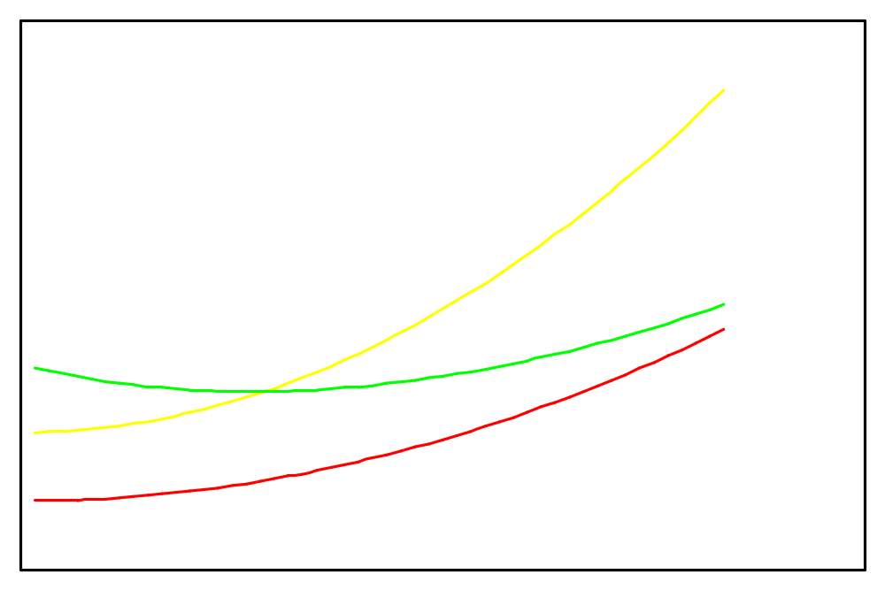
The function f(x) is O(g(x))
3.2 The Growth of Function
C g(x)
f(x)
g(x)
k
x

Slide 24
Note:
3.2 The Growth of Function
1. Equivalent expressions:
f(x) = O(g(x))
f(x) ∈ O (g(x))
2. The pair C, k satisfiers the definition is never unique. Moreover, if one such pair exists, there are infinitely many such pairs.
3. When f(x) is O(g(x)) , and h(x) is a function that has larger absolute values than g(x) does for sufficiently large values of x, it follows that f(x) is O(h(x)) .

Slide 25
O(n³)
f(n) = 12n² + n
O(n²)
f(n) = n^{2.5}
Faster Growing
f(n) = n^{3.1} – n²

Slide 26
3.2 The Growth of Function
〖Example 1〗 Show that f(x) = x² + 2x + 1 is O(x²).
Solution：
1) f(x) = x² + 2x + 1
For all x > 1
≤ x² + 2x² + 1
≤ x² + 2x² + x²
For all x > 1
= 4x²
= Cx²
= Cg(x)
We have: C = 4, k = 1, g(x) = x²
f(x) is O(x²)
2) 0 ≤ x² + 2x + 1 ≤ x² + x² + x² = 3x² whenever x>2
3) x² is O(x²+2x+1)
Note: Two functions f(x) and g(x) that satisfy both of these big-O relationships are of the same order.

Slide 27
3.2 The Growth of Function
〖Example 2〗 Show that 7x² is O(x³). Is it also true x³ is O(7x²)?
Solution：
1) Note that when x>7, we have 7x² <x³. Consequently, we can take C=1, and k=7, and to establish the relation 7x² is O(x³).
2) x³≤ C(7x²)
x≤ 7C
Note that no C exists for which x≤ 7C for all x>k.

Slide 28
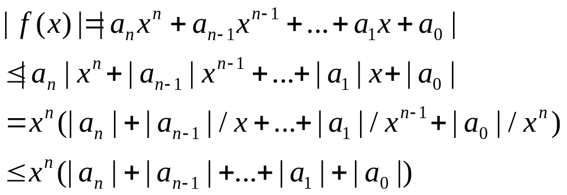
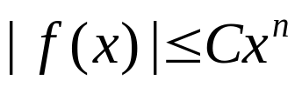
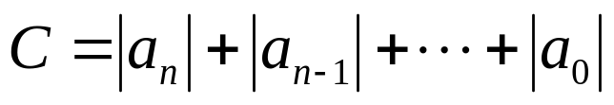
Some Important Big-O Results
3.2 The Growth of Function
【Theorem】 Let f(x) = a_{n}x^{n} + a_{n-1}x^{n-1} +…+ a₁x+ a₀,where a₀, a₁ ,…, a_{n} are real numbers. Then f(x) is O(x^{n}).
Proof:
Using the triangle inequality, if x>1 we have
It follows that
where whenever x>1

Slide 29
Some Important Functions
3.2 The Growth of Function
Complexity Term
O(1) constant
O(log n) logarithmic
O(n) linear
O(n log n) n log n
O(n^{b}) polynomial
O(b^{n}) b > 1 exponential
O(n!) factorial

Slide 30
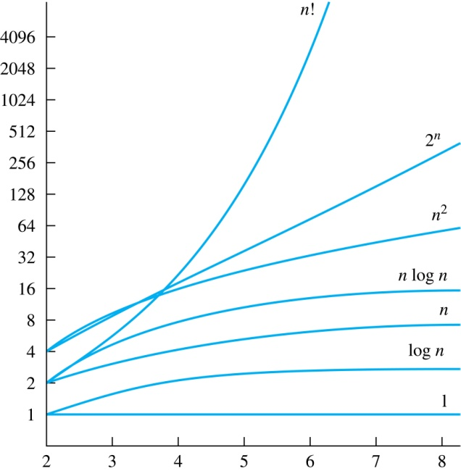
Growth of Some Common Functions
3.2 The Growth of Function

Slide 31
Growth of Combinations of Functions
3.2 The Growth of Function
(1) Addition of functions
  If f₁(x) is O(g₁(x)) and f₂(x) is O(g₂(x)),
  then (f₁ + f₂)(x) is O(max(g₁(x),g₂(x))).
〖Example 4〗 What is the complexity of the function n² + log(n!) ?
Solution:
n² = O(n²)
log(n!) = O(n log n)
Since O(n²) > O(n log n),
n² +n log(n!) = O(n²)

Slide 32
Growth of Combinations of Functions
3.2 The Growth of Function
(2) Multiplication of functions
  If f₁(x) is O(g₁(x)) and f₂(x) is O(g₂(x)),
  then (f₁f₂)(x) is O(g₁(x)g₂(x)).
〖Example 5〗 What is the complexity of the function 3nlog(n!) ?
Solution:
3n = O(n)
log(n!) = O(n log n)
3nlog(n!) = O(n ×n log n) = O(n²log n)

Slide 33
Ordering Functions by Order of Growth
3.2 The Growth of Function
〖Example 6〗Put the functions below in order so that each function is big-O of the next function on the list.
f₁(n) = (1.5)^{n} f₂(n) = 8n³+17n² +11 1
f₃(n) = (log n )² f₄(n) = 2^{n}
f₅(n) = log (log n) f₆(n) = n² (log n)³
f₇(n) = 2^{n} (n² +1) f₈(n) = n³+ n(log n)²
f₉(n) = 10000, f₁₀(n) = n!

Slide 34
Big-Omega
3.2 The Growth of Function
f(x)=O(g(x)) only provides an upper bound in terms of g(x) for f(x).
What do we do for a lower bound?
Big-Omega provides a lower bound for a function within a constant factor.
【Definition】 Let f and g be functions from Z (or R) to R. We say that “f(x) is Ω(g(x))” if there are constants C and k such that
  | f(x)| ≥ C| g(x)|
  whenever x> k.

Slide 35
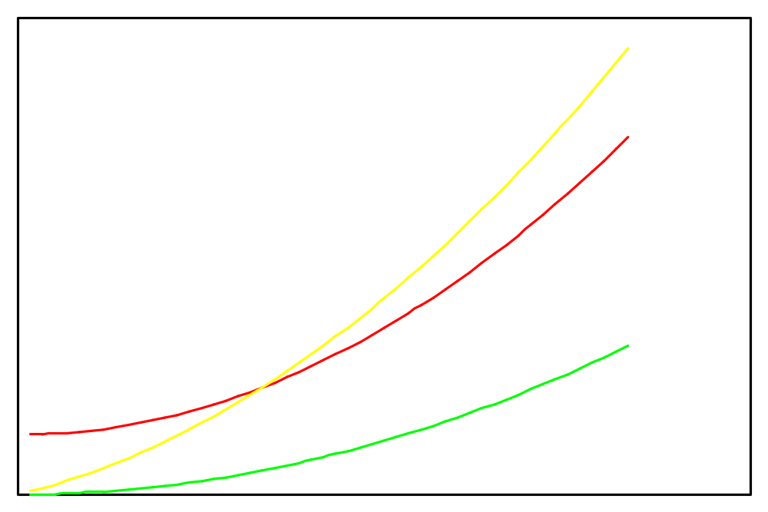
Big-Omega
3.2 The Growth of Function
f(x)
Cg(x)
g(x)
k
x

Slide 36
3.2 The Growth of Function
〖Example 6〗 Show that f(x) = 8x³ + 5x² + 7 is Ω(x³).
Solution:
f(x) = 8x³ + 5x² + 7
≥ 8x³
For all x > 1
= Cx³
= Cg(x)
We have: C = 8, k = 1, g(x) = x³
f(x) is Ω(x³)

Slide 37
Big-Theta
3.2 The Growth of Function
f(x)=O(g(x)) only provides an upper bound in terms of g(x) for f(x).
f(x)=Ω(g(x)) only provides a lower bound in terms of g(x) for f(x).
Big-Theta provides both an upper bound and a lower bound for a function in terms of a reference function g(x)

Slide 38
Big-Theta
3.2 The Growth of Function
【Definition】 Let f and g be functions from Z (or R) to R. We say that “f(x) is Θ(g(x))” if “f(x) is O(g(x))” and “f(x) is Ω(g(x))”, i.e., there are constants C₁, C₂, and k such that
  0 ≤ C₁g(x) ≤ f(x) ≤ C₂g(x)
  whenever x > k.
f(x) is Θ(g(x)) is read as:
  “f(x) is big-Theta of g(x)”
  “f(x) is of order g(x)”

Slide 39
Big-Theta
3.2 The Growth of Function
C₂g(x)
f(x)
C₁g(x)
k
x

Slide 40
3.2 The Growth of Function
〖Example 7〗 Show that f(x) = 3x² + 8xlogx is Θ(x²).
Solution:
f(x) = 3x² + 8xlogx
≤ 3x² + 8x²
For x >1
f(x) is O(x²)
= 11x²
= C₂x²
= C₂g(x)
f(x) = 3x² + 8xlogx
≥ 3x²
For x > 1
f(x) is Ω(x²)
= C₁x²
= C₁g(x)
We have: C₁ = 3, C₂ = 11, k = 1, g(x) = x²
f(x) is Θ(x²)

Slide 41
Homework (Due on Mar. 30)
Ver. 7 & Ver. 8
Sec. 3.1 2, 4
Sec. 3.2 8(c), 26(a), 54, 56

